Slide 1

Automata Theory Lecture 01: Basic Concepts
Farhad Muhammad Riaz

Slide 2
Lecture Outline
Personal
Administrivia
Basic Set Concepts
Set Theory
Functions
Relations
Trees and Graph
Language and type

Slide 3
Personel
Instructor:
Farhad Muhammad Riaz
Office hours: after class + Drop in when you’re around + Appointments
Research Area:
Deep Learning/ Machine Learning
Subject Area:
Design and Analysis of Algorithms, Automata Theory, Compiler Construction, Database Systems, Parallel and Distributed Systems, Discrete Structure, Digital Image Processing, ML,AI

Slide 4
Administrivia
Class Time Table
Tuesday: 09:20 - 10:35 M 4:35 -7:10 E
Venue: Room # 66 – Ghazali Block
Venue: Room # 65 – Ghazali Block
Friday: 09:20 - 10:35
Venue: Room # 35 – Ghazali Block

Slide 5
Course Project
At the end of the semester students needs to submit a semester project like
Complexity studies on Natural Language Processing.
Basic computational learning theory.
The Mathematics of Social Networks
Finite automata for speech recognition
Modeling human languages using context-free languages and grammars

Slide 6
Prerequisites
Assume undergrad courses in:
Data structures & algorithms
Linked lists, dictionaries, trees, hash tables, &c
Discrete Structures

Slide 7
Requirements & Grading
Roughly
50 % Final Exam
25% Internal Evaluation
Quiz 5 Marks
Assignments 5 Marks
Project 15 Marks
25% Mid term exam

Slide 8
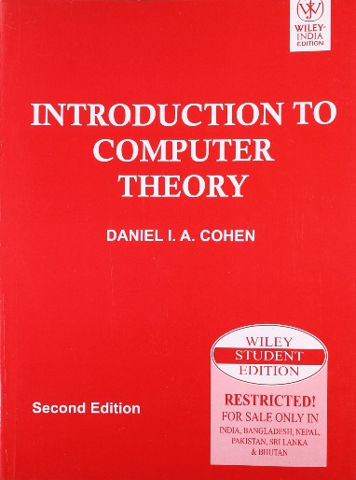

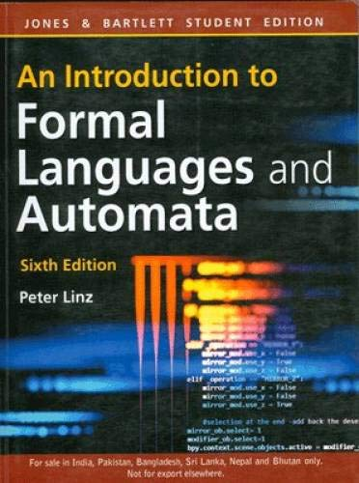
Books
Three good books:
Introduction to Automata Theory, 2nd edition, by Daneal I.A Cohen.
Automata, Computability and Complexity: Theory and Applications, by Elaine Rich, 2011
An Introduction to Formal Languages and Automata, By Peter Linz, 4th edition, Jones & Bartlett Publishers, 2006

Slide 9
Set and Set Operations
A Set is a collection of objects called members. If a, b, c, d are members of a set S we write :
S ={a, b, c, d} where a, b, c, d ∈ S ( read a, b, c, d belong to S )
The set builder notation can be used to define a set.
For example, the set
S={1, 3, 5, 7, 11, 13} can be defined as
S = {x: where x is prime number and x<15}

Slide 10
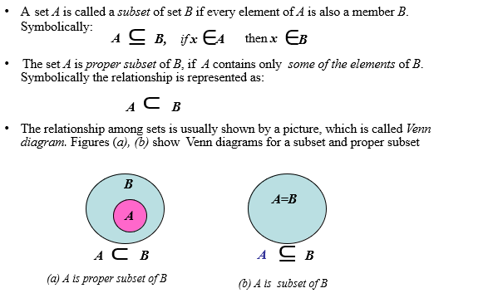
Set and Set Operations

Slide 11
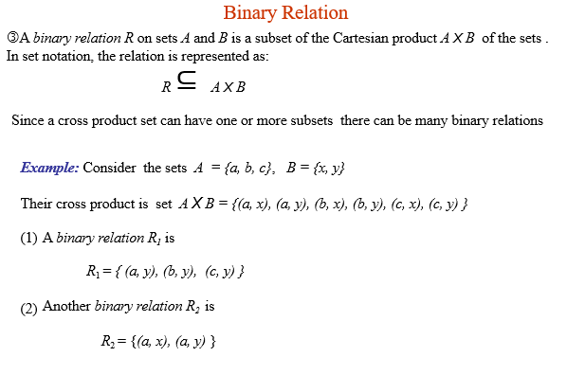
Set and Set Operations

Slide 12
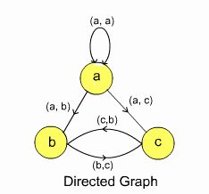
Set and Set Operations
Binary Relation
A graph G is a pair (V, E ), where V is a finite set, called vertex set, and E is a binary relation on V, called edge set
Example: Consider the graph G = (V, E) , and V = { a, b, c }, vertex set for the graph
A binary relation is
E = {(a, a), (a, b), (a, c), (b, c), (c, b) }
The set E represents
edges of graph G. The graph is shown pictorially
in the diagram below.

Slide 13
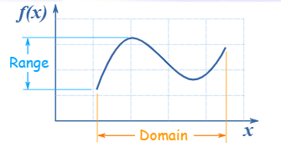
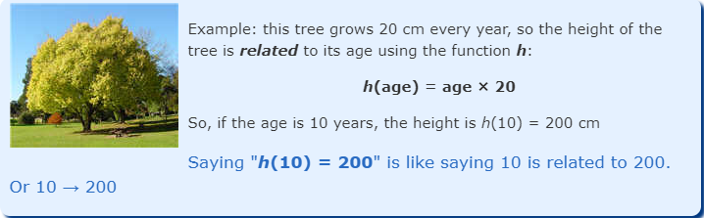
Functions
A function relates an input to an output

Slide 14
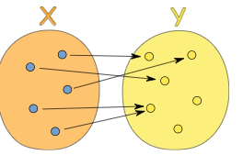
Functions
A function relates each element of a set with exactly one element of another set (possibly the same set).

Slide 15
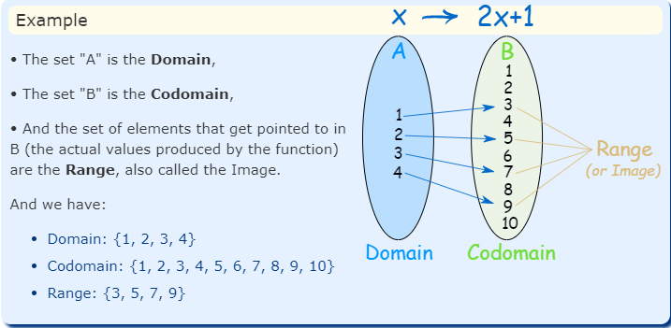
Functions

Slide 16
Trees and Graphs
Tree is a non-linear data structure in which elements are arranged in multiple levels.
It is a collection of edges and nodes. For example, node is represented by N and edge is represented as E, so it can be written as: T = {N,E}

Slide 17
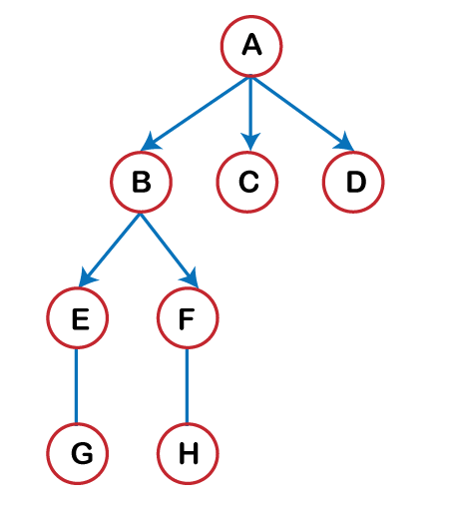
Trees and Graphs
Root node: The topmost node in a tree data structure is known as a root node. A root node is a node that does not have any parent.
Path: It is a sequence of the consecutive edges from a source node to the destination node. Here edge is a link between two nodes.
Sibling: All the children that have the same parent node are known as siblings.
Degree: The number of children of a particular node is known as a degree.
Depth of node: The length of the path from the root to that node is known as a depth of a node.
Height of a node: The number of edges that occur in the longest path from that node to the leaf node is known as the height of a node.
Level of node: The number of edges that exist from the root node to the given node is known as a level of a node.

Slide 18
Trees and Graphs
A Graph is also a non-linear data structure.
It is a collection of vertices and edges.
For example, vertices are represented by V, and edge is represented as 'E', so it can be written
T = {V, E}

Slide 19
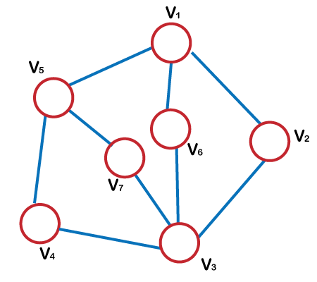
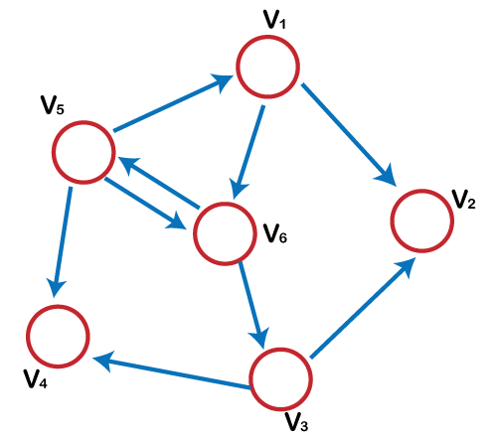
Trees and Graphs

